Slide 1
Introduction to Computer Program and Java

Slide 2
Outline
Chapter 1, Introduction to Java (week1-2)
Chapter 2, Primitive Data Types and Operators (week3-4)
Chapter 3, Selection Statements (week 5-6)
Chapter 4, Loops (week 7-8)
Midterm (week 9)
Chapter 5, Methods (week 10)
Chapter 6, Arrays (week 11)
Chapter 7, Objects and Classes (week 12-13)
Chapter 8, Strings (week14-15)
Final exam (week 16)

Slide 3
Objectives
To review computer basics, programs
To understand the relationship between Java and the World Wide Web (§1.6).
To know Java’s advantages (§1.7).
To distinguish the terms API, IDE, and JDK (§1.8).
To write a simple Java program (§1.9).
To create, compile, and run Java programs (§1.10).
To understand the Java runtime environment (§1.10).
To know the basic syntax of a Java program (§1.11).

Slide 4
Programs
Computer programs, known as software, are instructions to the computer.
You tell a computer what to do through programs. Without programs, a computer is an empty machine. Computers do not understand human languages, so you need to use computer languages to communicate with them.
Programs are written using programming languages.

Slide 5
Programming Languages
Machine Language Assembly Language High-Level Language
Machine language is a set of primitive instructions built into every computer. The instructions are in the form of binary code, so you have to enter binary codes for various instructions. Program with native machine language is a tedious process. Moreover the programs are highly difficult to read and modify. For example, to add two numbers, you might write an instruction in binary like this:
  1101101010011010

Slide 6
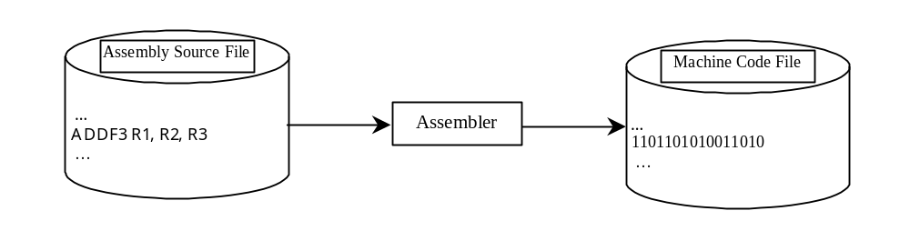
Programming Languages
Machine Language Assembly Language High-Level Language
Assembly languages were developed to make programming easy. Since the computer cannot understand assembly language, however, a program called assembler is used to convert assembly language programs into machine code. For example, to add two numbers, you might write an instruction in assembly code like this:
ADDF3 R1, R2, R3

Slide 7
Programming Languages
Machine Language Assembly Language High-Level Language
The high-level languages are English-like and easy to learn and program. For example, the following is a high-level language statement that computes the area of a circle with radius 5:
area = 5 * 5 * 3.1415;

Slide 8
Popular High-Level Languages
COBOL (COmmon Business Oriented Language)
FORTRAN (FORmula TRANslation)
BASIC (Beginner All-purpose Symbolic Instructional Code)
Pascal (named for Blaise Pascal)
Ada (named for Ada Lovelace)
C (whose developer designed B first)
Visual Basic (Basic-like visual language developed by Microsoft)
Delphi (Pascal-like visual language developed by Borland)
C++ (an object-oriented language, based on C)
Java (We use it in the book)

Slide 9
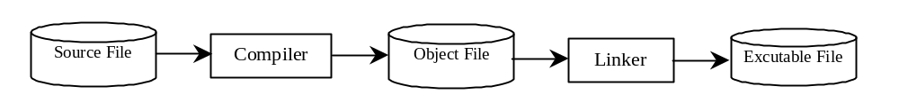
Compiling Source Code
A program written in a high-level language is called a source program. Since a computer cannot understand a source program. Program called a compiler is used to translate the source program into a machine language program called an object program. The object program is often then linked with other supporting library code before the object can be executed on the machine.

Slide 10
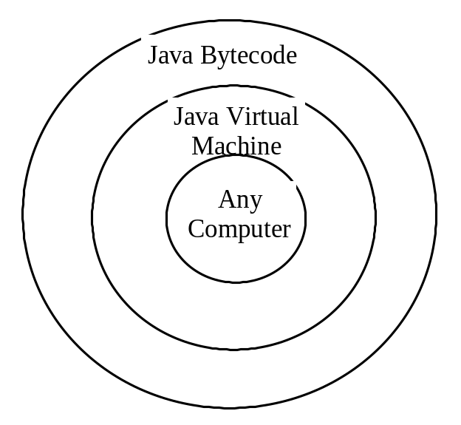
Compiling Java Source Code
You can port a source program to any machine with appropriate compilers. The source program must be recompiled, however, because the object program can only run on a specific machine. Nowadays computers are networked to work together. Java was designed to run object programs on any platform. With Java, you write the program once, and compile the source program into a special type of object code, known as bytecode. The bytecode can then run on any computer with a Java Virtual Machine, as shown in Figure 1.5. Java Virtual Machine is a software that interprets Java bytecode.

Slide 11
Why Java?
The answer is that Java enables users to develop and deploy applications on the Internet for servers, desktop computers, and small hand-held devices. The future of computing is being profoundly influenced by the Internet, and Java promises to remain a big part of that future. Java is the Internet programming language.
Java is a general purpose programming language.
Java is the Internet programming language.

Slide 12
Java, Web, and Beyond
Java can be used to develop Web applications.
Java Applets
Java Servlets and JavaServer Pages
Java can also be used to develop applications for hand-held devices such as Palm and cell phones

Slide 13
Examples of Java’s Versatility
Standalone Application: TicTacToe
Applet: TicTacToe
Servlets: SelfTest Web site
Mobile Computing: Cell phones

Slide 14
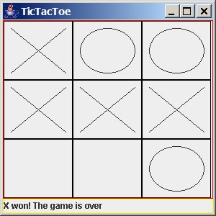
TicTacToe Standalone

Slide 15
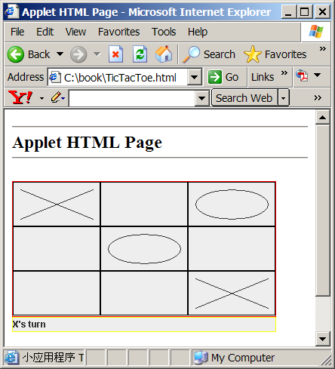
TicTacToe Applet

Slide 16
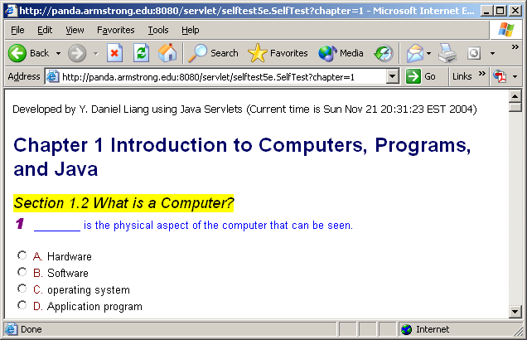
SelfTest Website (using Java Servlets)

Slide 17
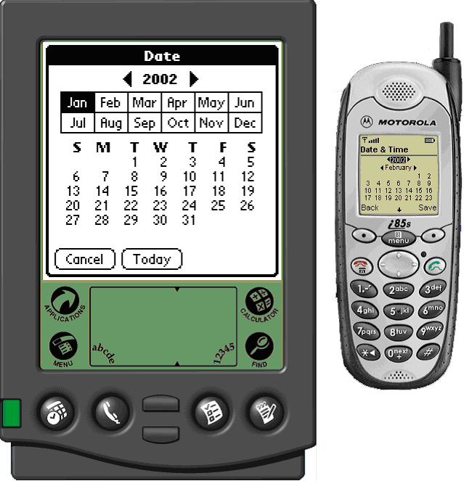
PDA and Cell Phone

Slide 18
Java’s History
James Gosling and Sun Microsystems
Oak
Java, May 20, 1995, Sun World
HotJava
  The first Java-enabled Web browser
Early History Website:
http://java.sun.com/features/1998/05/birthday.html

Slide 19
Characteristics of Java
Optional
Java Is Simple
Java Is Object-Oriented
Java Is Distributed : easy to control
Java Is Interpreted
Java Is Robust
Java Is Secure : have security
Java Is Architecture-Neutral : multi OS
Java Is Portable
Java's Performance
Java Is Multithreaded
Java Is Dynamic
www.cs.armstrong.edu/liang/intro6e/JavaCharacteristics.pdf

Slide 20
Characteristics of Java
Optional
Java Is Simple
Java Is Object-Oriented
Java Is Distributed
Java Is Interpreted
Java Is Robust
Java Is Secure
Java Is Architecture-Neutral
Java Is Portable
Java's Performance
Java Is Multithreaded
Java Is Dynamic
Java is partially modeled on C++, but greatly simplified and improved. Some people refer to Java as "C++--" because it is like C++ but with more functionality and fewer negative aspects.

Slide 21
Characteristics of Java
Optional
Java Is Simple
Java Is Object-Oriented
Java Is Distributed
Java Is Interpreted
Java Is Robust
Java Is Secure
Java Is Architecture-Neutral
Java Is Portable
Java's Performance
Java Is Multithreaded
Java Is Dynamic
Java is inherently object-oriented. Although many object-oriented languages began strictly as procedural languages, Java was designed from the start to be object-oriented. Object-oriented programming (OOP) is a popular programming approach that is replacing traditional procedural programming techniques.
One of the central issues in software development is how to reuse code. Object-oriented programming provides great flexibility, modularity, clarity, and reusability through encapsulation, inheritance, and polymorphism.

Slide 22
Characteristics of Java
Optional
Java Is Simple
Java Is Object-Oriented
Java Is Distributed
Java Is Interpreted
Java Is Robust
Java Is Secure
Java Is Architecture-Neutral
Java Is Portable
Java's Performance
Java Is Multithreaded
Java Is Dynamic
Distributed computing involves several computers working together on a network. Java is designed to make distributed computing easy. Since networking capability is inherently integrated into Java, writing network programs is like sending and receiving data to and from a file.

Slide 23
Characteristics of Java
Optional
Java Is Simple
Java Is Object-Oriented
Java Is Distributed
Java Is Interpreted
Java Is Robust
Java Is Secure
Java Is Architecture-Neutral
Java Is Portable
Java's Performance
Java Is Multithreaded
Java Is Dynamic
You need an interpreter to run Java programs. The programs are compiled into the Java Virtual Machine code called bytecode. The bytecode is machine-independent and can run on any machine that has a Java interpreter, which is part of the Java Virtual Machine (JVM).

Slide 24
Characteristics of Java
Optional
Java Is Simple
Java Is Object-Oriented
Java Is Distributed
Java Is Interpreted
Java Is Robust
Java Is Secure
Java Is Architecture-Neutral
Java Is Portable
Java's Performance
Java Is Multithreaded
Java Is Dynamic
Java compilers can detect many problems that would first show up at execution time in other languages.
Java has eliminated certain types of error-prone programming constructs found in other languages.
Java has a runtime exception-handling feature to provide programming support for robustness.

Slide 25
Characteristics of Java
Optional
Java Is Simple
Java Is Object-Oriented
Java Is Distributed
Java Is Interpreted
Java Is Robust
Java Is Secure
Java Is Architecture-Neutral
Java Is Portable
Java's Performance
Java Is Multithreaded
Java Is Dynamic
Java implements several security mechanisms to protect your system against harm caused by stray programs.

Slide 26
Characteristics of Java
Optional
Java Is Simple
Java Is Object-Oriented
Java Is Distributed
Java Is Interpreted
Java Is Robust
Java Is Secure
Java Is Architecture-Neutral
Java Is Portable
Java's Performance
Java Is Multithreaded
Java Is Dynamic
Write once, run anywhere
With a Java Virtual Machine (JVM), you can write one program that will run on any platform.

Slide 27
Characteristics of Java
Optional
Java Is Simple
Java Is Object-Oriented
Java Is Distributed
Java Is Interpreted
Java Is Robust
Java Is Secure
Java Is Architecture-Neutral
Java Is Portable
Java's Performance
Java Is Multithreaded
Java Is Dynamic
Because Java is architecture neutral, Java programs are portable. They can be run on any platform without being recompiled.

Slide 28
Characteristics of Java
Optional
Java Is Simple
Java Is Object-Oriented
Java Is Distributed
Java Is Interpreted
Java Is Robust
Java Is Secure
Java Is Architecture-Neutral
Java Is Portable
Java's Performance
Java Is Multithreaded
Java Is Dynamic
Java’s performance Because Java is architecture neutral, Java programs are portable. They can be run on any platform without being recompiled.

Slide 29
Characteristics of Java
Optional
Java Is Simple
Java Is Object-Oriented
Java Is Distributed
Java Is Interpreted
Java Is Robust
Java Is Secure
Java Is Architecture-Neutral
Java Is Portable
Java's Performance
Java Is Multithreaded
Java Is Dynamic
Multithread programming is smoothly integrated in Java, whereas in other languages you have to call procedures specific to the operating system to enable multithreading.

Slide 30
Characteristics of Java
Optional
Java Is Simple
Java Is Object-Oriented
Java Is Distributed
Java Is Interpreted
Java Is Robust
Java Is Secure
Java Is Architecture-Neutral
Java Is Portable
Java's Performance
Java Is Multithreaded
Java Is Dynamic
Java was designed to adapt to an evolving environment. New code can be loaded on the fly without recompilation. There is no need for developers to create, and for users to install, major new software versions. New features can be incorporated transparently as needed.

Slide 31
JDK Versions
JDK 1.02 (1995)
JDK 1.1 (1996)
JDK 1.2 (1998)
JDK 1.3 (2000)
JDK 1.4 (2002)
JDK 1.5 (2004) a. k. a. JDK 5 or Java 5
JDK : Java Development Kit

Slide 32
JDK Editions
Note
Java Standard Edition (J2SE)
  J2SE can be used to develop client-side standalone applications or applets. Run is PC.
Java Enterprise Edition (J2EE)
  J2EE can be used to develop server-side applications such as Java servlets and Java Server Pages.
Java Micro Edition (J2ME).
  J2ME can be used to develop applications for mobile devices such as cell phones.
This course uses J2SE to introduce Java programming.

Slide 33
Java IDE Tools
Borland JBuilder
NetBeans Open Source by Sun
Sun ONE Studio by Sun MicroSystems
Eclipse Open Source by IBM

Slide 34
A Simple Java Program
Listing 1.1
//This program prints Welcome to Java!
public class Welcome {
public static void main(String[] args) {
System.out.println("Welcome to Java!");
}
}

Slide 35

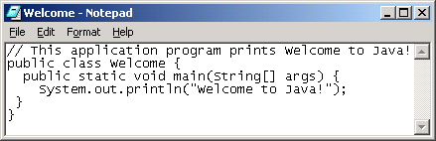
Creating and Editing Using NotePad
To use NotePad, type
  notepad Welcome.java
from the DOS prompt.

Slide 36

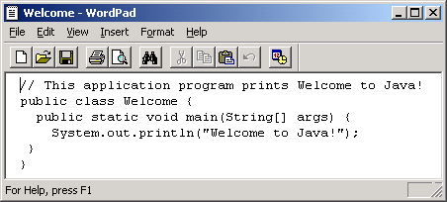
Creating and Editing Using WordPad
To use WordPad, type
  write Welcome.java
from the DOS prompt.

Slide 37
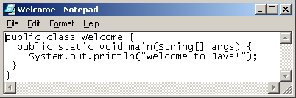
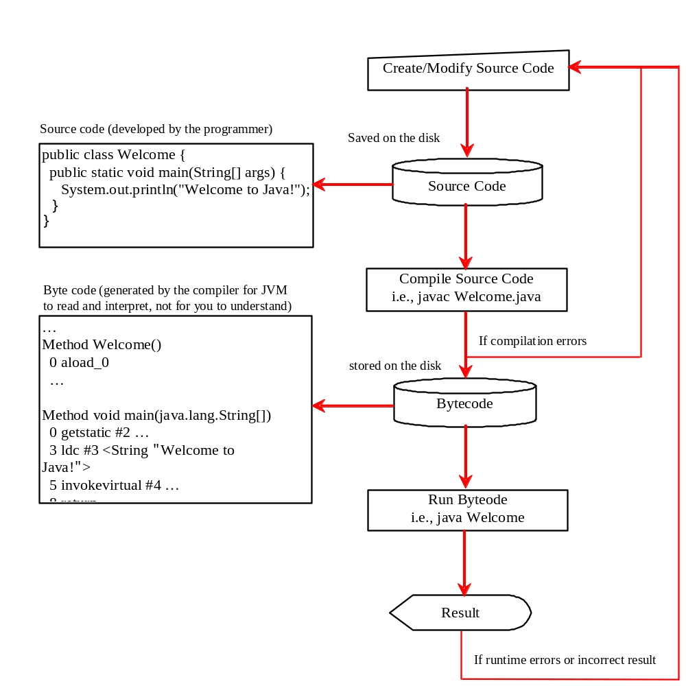
Creating, Compiling, and Running Programs

Slide 38
Trace a Program Execution
animation
Enter main method
//This program prints Welcome to Java!
public class Welcome {
public static void main(String[] args) {
System.out.println("Welcome to Java!");
}
}

Slide 39
Trace a Program Execution
animation
Execute statement
//This program prints Welcome to Java!
public class Welcome {
public static void main(String[] args) {
System.out.println("Welcome to Java!");
}
}

Slide 40

Trace a Program Execution
animation
//This program prints Welcome to Java!
public class Welcome {
public static void main(String[] args) {
System.out.println("Welcome to Java!");
}
}
print a message to the console

Slide 41

Compiling and Running Java from the Command Window
Set path to JDK bin directory
  set path=c:\Program Files\java\jdk1.5.0\bin
Set classpath to include the current directory
  set classpath=.
Compile
  javac Welcome.java
Run
  java Welcome

Slide 42

Compiling and Running Java from TextPad
TextPad Optional
See Supplement B on the Website for details

Slide 43
Anatomy of a Java Program
Comments
Reserved words
Modifiers
Statements
Blocks
Classes
Methods
The main method

Slide 44
Comments
In Java, comments are preceded by two slashes (//) in a line, or enclosed between /* and */ in one or multiple lines. When the compiler sees //, it ignores all text after // in the same line. When it sees /*, it scans for the next */ and ignores any text between /* and */.

Slide 45
Reserved Words
Reserved words or keywords are words that have a specific meaning to the compiler and cannot be used for other purposes in the program. For example, when the compiler sees the word class, it understands that the word after class is the name for the class. Other reserved words in Listing 1.1 are public, static, and void. Their use will be introduced later in the book.

Slide 46
Modifiers
Java uses certain reserved words called modifiers that specify the properties of the data, methods, and classes and how they can be used. Examples of modifiers are public and static. Other modifiers are private, final, abstract, and protected. A public datum, method, or class can be accessed by other programs. A private datum or method cannot be accessed by other programs. Modifiers are discussed in Chapter 6, “Objects and Classes.”

Slide 47
Statements
A statement represents an action or a sequence of actions. The statement System.out.println("Welcome to Java!") in the program in Listing 1.1 is a statement to display the greeting "Welcome to Java!" Every statement in Java ends with a semicolon (;).

Slide 48

Blocks
A pair of braces in a program forms a block that groups components of a program.

Slide 49
Classes
The class is the essential Java construct. A class is a template or blueprint for objects. To program in Java, you must understand classes and be able to write and use them. The mystery of the class will continue to be unveiled throughout this book. For now, though, understand that a program is defined by using one or more classes.

Slide 50
Methods
What is System.out.println? It is a method: a collection of statements that performs a sequence of operations to display a message on the console. It can be used even without fully understanding the details of how it works. It is used by invoking a statement with a string argument. The string argument is enclosed within parentheses. In this case, the argument is "Welcome to Java!" You can call the same println method with a different argument to print a different message.

Slide 51
main Method
The main method provides the control of program flow. The Java interpreter executes the application by invoking the main method.
The main method looks like this:
public static void main(String[] args) {
// Statements;
}

Slide 52
Eclipse IDE
Eclipse IDE was used in this class

